Slide 1


Advancing Health through Evidence-Assisted Decisions
with Health Policy and Systems Research
Notes:
Background and Rationale:
EO 102 (s.1999) National Health Research Agenda
Mandate as co-lead of the PNHRS with PCHRD

Slide 2


Health Policy Research & Universal Health Coverage
The Vision
Health Policy and Systems Research (HPSR) as the “GPS for health decision-making.”
Countries that have implemented successful Universal Health Coverage reforms (China, Thailand, Mexico and India) share common features such as
HPSR institutions with able leadership and competent staff;
involvement and influence of prominent health researchers and health leaders in advocating and highlighting the role and promise of HPSR;
increased allocation of resources towards HPSR;
prominent role of press and public opinion in highlighting important issues related to health policy and health systems;
positive contribution of international funders in strengthening the generation of evidence and its use locally;
orchestrated efforts to embed research into decision-making;
use of evaluation as a tool for learning, transparency and the scale-up of programme

Slide 3



The Vision
The Vision
VISION
Policymakers
Legislators
A vibrant community of health policy and systems researchers and decision-makers committed to producing and using the best available evidence in all policies, plans and programs towards the attainment of health system goals.
clinical research needs
health policy and systems research needs
Researchers, Communicators
Entrepreneurs, Influencers
Health Policy and Systems Research “Institute”
Academic &
Research Institutions
arms-length think tank

Slide 4



AHEAD-HPSR General Objectives
To inform the health sector’s global and national administrative and legislative policy agenda
To create an equitable and enabling environment for health policy and systems researchers & institutions all over the country
To position the Philippines as a regional & global knowledge contributor

Slide 5







Program Framework
Evidence informed:
Funds
Research Agenda
Research Management (Grants Administration)
Financial Risk Protection
Technical reports, journal publications, evidence summaries
Policies
Researchers & Research Institutions
Critical mass of skilled policymakers and researchers
Better Health Outcomes
Ethics Review
Programs
Policymakers & Decision-makers
Briefs, Infographics, Videos
Capacity Development
Responsiveness
Young Professionals
Actions
Open Data Sets

Slide 6




Program Components
Research
Agenda &
Projects
Capacity
Development
Research
Dissemination
Ethics

Slide 7
Implementing Partner
Philippine Council for Health Research and Development
Mandate & capacity for
Grants administration and management
Fellowship administration
De-facto secretariat for the Philippine National Health Research System (RA 10352, 2013)

Slide 8

Research Agenda
1. Establishing Need
2. Identifying Solutions
3. Setting Standards
4. Ensuring Accountability

Slide 9

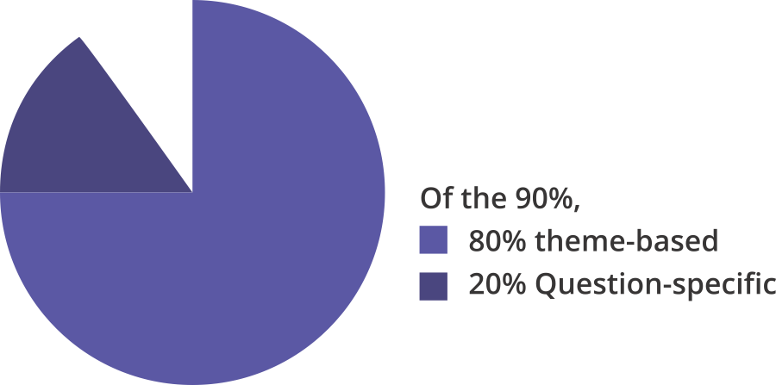
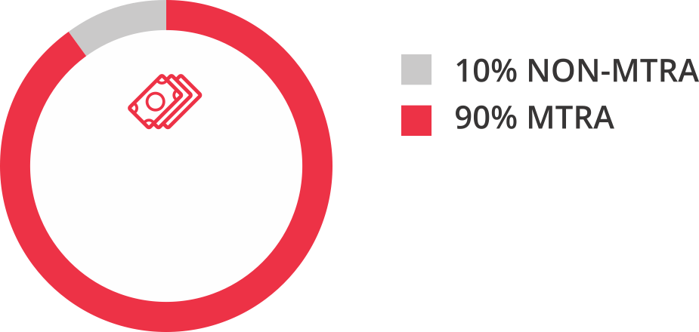
Allocation of Research Funds
Research
Funds

Slide 10



Research Projects
SMALL GRANTS
BIG GRANTS
< P5 million
<12 months
Senior researcher
SPECIFIC, DETAILED TOR
<P25 million
< 3 years
Senior + Emerging researcher
Intent to be Center of Excellence
Proof of continued interest & other counterpart grants
OPEN CALL, with Medium-Term Research Agenda as guide
2012 – 2017 – Total of XX projects
2018 – Awarding XX grants by April 2018
2017 – Awarded first batch of 5 institutions

Slide 11
Research Projects
INSTITUTION | TOPIC
UP College of Medicine | Patient Safety
Addictus Research and Intervention Center, Inc. | Drug Addiction
Ateneo School of Medicine and Public Health | Mental Health
UP College of Medicine | Patient Safety
EpiMetrics, Inc. | Health Promotion
UP National Institutes of Health | Healthy Aging
BIG GRANTS
8-month preparation
DOH Local Committee
International Panel of Experts
British Medical Journal
USAID
ADB
Independent: Oscar Picazo

Slide 12





Capacity Development
Implementation Phase
Preparatory Phase
Internship for undergraduate, graduate students
Short-term visiting research programs & thesis based degree-granting programs
Twinning between research institutions
Fellowship for young professionals
Ateneo de Manila
UP College of Medicine
Harvard Kennedy School
Group Research Paper
Individual Policy Notes/Briefs
Critical Appraisal of Research
Imperial College London
Mahidol University
HITAP
International Health Policy Program – Thailand
Institute for Health Metrics & Evaluation, University of Washington - USA

Slide 13



Fellowship for Young Professionals
Health Policy and Systems Research
Health in All Policies
Health Equity
Health Financing
Health Technology Assessment
Health Research Impact
Performance Measurement and Operations Research
Health Planning and Budgeting
Monitoring and Evaluation
Hospital Financial Management
Logistics
Procurement
*Managed by Health Research Division
*Managed by Health Planning Division

Slide 14

Request for EXECOM Approval
Disbursement of Php 250M 2nd Tranche to PCHRD

Slide 15
Background
DOH initiated the 2017 MOA with PCHRD originally with 5 tranches. However, in view of the discontinuation of the CONAP, Finance Service advised that
MOA be amended to reflect two tranches only and that second tranche must be appropriated by Dec 2017
MOA be amended to reflect signed MOA between DOH-PCHRD-Researcher of major projects as requirement to transfer fully all funds to PCHRD
DOH be included as a signatory in research contracts between PCHRD and the researchers
All other smaller projects which are indicated in Annex of the MOA will only be commissioned out in 2018, hence, not included as prerequisite for tranche release

Slide 16
Key Provisions / Deliverables
Deliverables
MOA with 5 institutions (big grants)
MOA for Mental Health Prevalence Survey
MOA for Health Literacy Survey
Fellowship Contracts for at least 45 HPSR Fellows
Annex X provides for XX number of research projects (small grants)
Requirements for release of funds
Tranche 1: Inception Report
Tranche 2: Deliverables 1-4 only
ISSUE: Deliverable 2 & 3 not ready until May 15

Slide 17
Status of Deliverables 2 & 3
Mental Health Prevalence Survey – undergoing technical and financial review due to multiple proposals received
Identified proponent by end-user office (DPCB): University of the Philippines Department of Psychiatry
expected completion date of review/negotiation is March 30
expected completion of signed MOA May 15
Health Literacy Survey – undergoing technical and financial review due to delays in receipt of revised proposals
Identified proponent by end-user office (HPCS): University of the Philippines College of Public Health
expected completion date of review/negotiation is March 15
expected completion of signed MOA April 30

Slide 18
Options
OPTION 1: Release of 2nd Tranche payments despite incomplete processing of the Mental Health and Health Literacy Survey
OPTION 2: Release 2nd tranche payments only after Mental Health Prevalence Survey and Health Literacy Survey are submitted
NOTE: AHEAD-HPSR Tranche 1 which was signed off by DOH on ___ has not yet been received by PCHRD due to delays on the part of the Department of Budget and Management. We anticipate the same lag in Tranche 2.

Slide 19
Implications of Delay
The 5 institutional grantees are expected to commence February 1, 2018 and present preliminary results by September 2018 at the National Health Research Forum for Action. In view of this, all have started to recruit and hire their research teams. The delays in downloading of funds would risk the projects not being able to secure their team, losing out to other possible employers, and imply that proponents will not be able to come up with a desirable output by September.
__ projects as stated in Annex A – the TORs for these projects have been posted last January 15 and per DO XX, all should be awarded by March 30 in order for the research projects to be completed by December 2018.
Engagement of the 45 HPSR fellows who require monthly stipend – The fellows’ stipend starting January 18 is being funded by ‘borrowing’ from PCHRD’s other trust funds due to payment delays by DOH. However, PCHRD has expressed that they cannot continue to do this. Hence, if no new funds come in by March, the fellows’ may not receive their monthly stipend

Slide 20
Recommendation
OPTION 1:
Release of 2nd Tranche payments while the Mental Health and Health Literacy Survey are still being processed

Slide 21
Health Policy and Systems Research Agenda
2016-2022

Slide 22
Research Agenda
This research agenda highlights the health policy and systems research areas where evidence is most needed.
The agenda is divided into 4 thematic areas:
1. Establishing Need
2. Identifying Solutions
3. Setting Standards
4. Ensuring Accountability

Slide 23
Establishing Need
Research that describes the status quo and provides detailed characterization of issues/ problems that require attention
Health and Nutrition Status
Health Literacy and Healthy Behavior Profile
Healthcare and Supply Side Mapping
Health Service Delivery Dimensions and Healthcare Utilization Patterns (and Non-utilization) and Service Coverage
Health Financing Flow and Burden and Sector-Wide Resource Requirement
LEGEND:
Continuing areas of research
New areas with little/no evidence generated for the country

Slide 24

Identifying Solutions
Research that generates and elaborates systems-based, scalable solutions
1
Health in All Policies
Priority Programs
Priority Populations
Access to Medicines
Cost-Effectiveness and Budget Impact Analysis
1
2
2
3
LEGEND:
Continuing areas of research
New areas with little/no evidence generated for the country

Slide 25
Setting Standards
Research that informs the development of standards that are critical in assuring healthcare quality and system efficiency
2
3
Cost Accounting and Price Reference Systems
Health Professional’/Workers’ Incentives
Procedural Terminologies and Disease Groupings
Clinical Practice Guidelines
Private Health Insurance and Health Maintenance Organizations
2
3
1
2
LEGEND:
Continuing areas of research
New areas with little/no evidence generated for the country

Slide 26
Ensuring Accountability
Research that provides objective assessment of program impact and design accountability mechanisms
1
2
Evaluation, Dissemination, and Action
Health Impact Assessment
3
1
LEGEND:
Continuing areas of research
New areas with little/no evidence generated for the country

